Slide 1
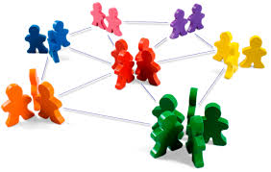
Week 6 Relationships: Building bridges

Slide 2
Learning objectives
At the end of this lecture, you should be able to:
Identify characteristics of human relationships.
Understand social exchange theory and its application in relationship development.
Recognise the challenges in building relationships with culturally different others.

Slide 3
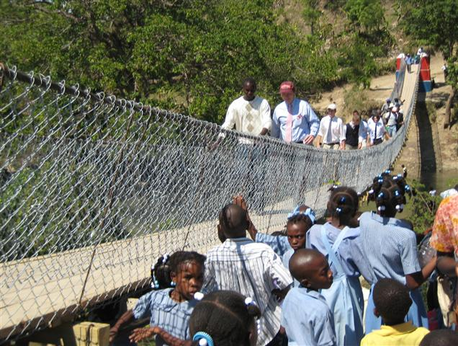

Slide 4
The bridge project in Ti Péligre
Bridges to Prosperity at Virginia Tech celebrated the
completion of its first project in 2012, a 60 metre
suspended footbridge in Ti Péligre, Haiti. Stone by stone and
nail by nail, a bridge was constructed after a year and a half
of effort by countless individuals .
What started as a simple project to help villagers gain
access to their most basic needs became something much
greater in my own life. Building bridges is not the solution
to changing the world, but we believe that there is a
solution we all can achieve: meaningful long-term
relationships.
Matt Capelli, a graduate student in VirginaTech

Slide 5
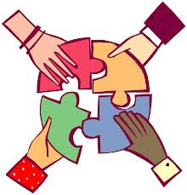
Human relationships
Human relationship can be defined as an interactional process of connecting ourselves with others in the network of social needs.
Could you list some important relationships you develop with others throughout your life?

Slide 6
William Schutz’s concept of social needs
We perpetually strive to fulfil three social needs through communication:
Inclusion: a sense of belonging.
Control: the ability to be in charge of our own life and to influence people around us.
Affection: the desire to show our love and to be loved by other persons.
Schutz, William (1966) The Interpersonal Underworld. Palo, Alto, CA: Science and Behavior Books.

Slide 7

What characterises human relationship
Dynamic:
Human relationships are ongoing and ever changing.
Hierarchical:
Different levels of relationship require different degree of involvement.
Reciprocal:
People in the relationship network satisfy each other’s needs for inclusion, control and affection.
Unique:
The development of different relationships require different social norms and rules.
Interdependent and irreplaceable:
People in a relationship network are connected; and individuals are unique and not replaceable in the network.
Chen, G-M., & Starosta, W. (2005). Foundations of intercultural communication.
Lanham, MD: American University Press.

Slide 8
Social exchange theory
Social exchange theory assumes that individuals establish and continue social relations based on expectations that such relations will be mutually beneficial.
If the calculated rewards are greater than the costs, we will continue to develop the relationship. If not, we might leave the existing relationship to seek a new one.
What can constitute rewards and costs in human relationships?

Slide 9

Think about these questions…
How do you get to know people who are different from you? Are these relationships different from those characterised by similarity?
What are some of the criteria we use to determine who we want to form friendships with and with whom we don't want to be associated?

Slide 10
Similarity attraction
We filter potential relational partners based on the extent to which we perceive that they are similar to us.
If we perceive our attitudes to be similar to someone else's, we tend to be attracted to them because they validate our view of the world.

Slide 11
Self-disclosure
Self-disclosure is used in almost all cultures as a means of developing relationships.
Cultural norms and values govern the degree to which self-disclosure is acceptable in interpersonal relationships.
What would be a potential consequence if a violation of expected level of self-disclosure occurred between the two communicators?

Slide 12
Friendship, romantic relationship and family
Although friendship, romantic relationships and family are universal across cultures our interpretation varies from culture to culture.
Different cultures place different values on different aspects of each of these types of relationships.

Slide 13
Technology and human relationships
Communication technologies, such as the mobile phone and the internet, have become an inseparable part of our daily lives. These were celebrated at the time of their invention as being able to overcome geographical boundaries and time constraints, hence bringing people across the world together.
But has this happened? How has Internet technology affected your relationships with friends or family?

Slide 14
After class…
Deception online has been an ongoing issue, for example, in some online dating websites. Could you suggest some strategies for dealing with deception online?

